Slide 1





Desafio
Desafio: Gere planos de ação a partir de análises com SQL
Este template visa orientar um formato para entrega, você pode alterá-los se quiser! Apenas mantenha as informações nos slides indicados!

Slide 2

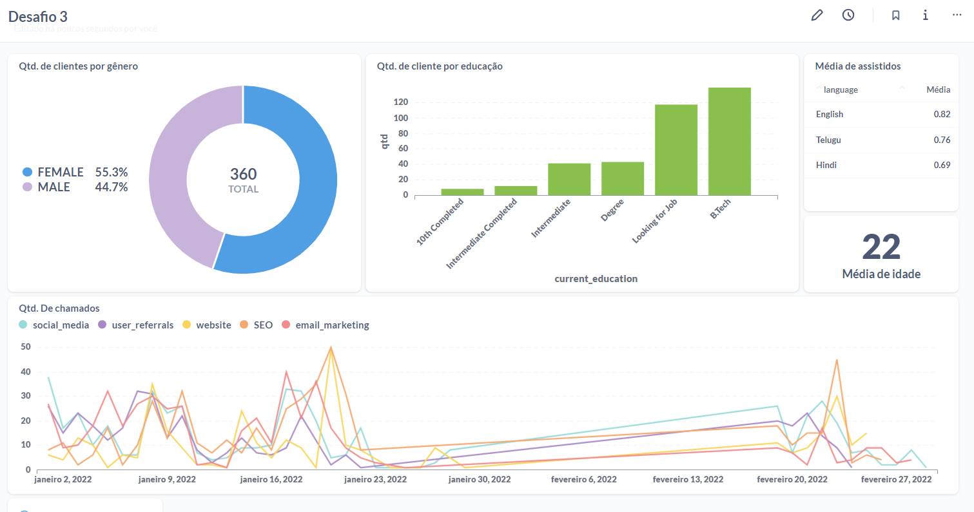
Dashboard
Insira o print do dashboard aqui

Slide 3
Gráfico 1 - (Qtd. De cliente por gênero)
Gráfico 2 - (Média de idade)
select count(lead_id) as usuarios, gender from leads_basic_details group by gender
select round(avg(age)) as "Média de idade“ from leads_basic_details
Gráfico 3 - (Alfabetização dos clientes)
Gráfico 4 - (Média de assistido)
Select count(lead_id) as qtd, current_education from leads_basic_details Group by current_educationorder by qtd order by qtd
with Porcentagem as ( select avg(watched_percentage) as Média, language fromleads_demo_watched_detailswhere watched_percentage > 0.5 group by language ) select * FROM Porcentagem order by Média desc

Slide 4
Gráfico 5 - (Qtd. De chamados)
WITH CHAMADOS AS ( select lead_id, call_done_datefrom leads_interaction_details) select count(CHAMADOS.lead_id), call_done_date, leads_basic_details.lead_gen_source from CHAMADOS right join leads_basic_details on leads_basic_details.lead_id = CHAMADOS.lead_id group by call_done_date, lead_gen_source

